Slide 1
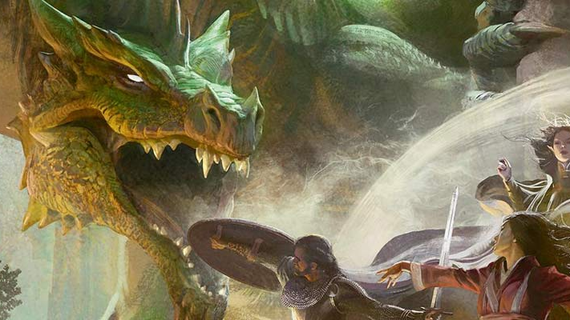
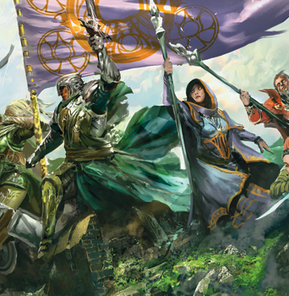

Adventure Day

Slide 2

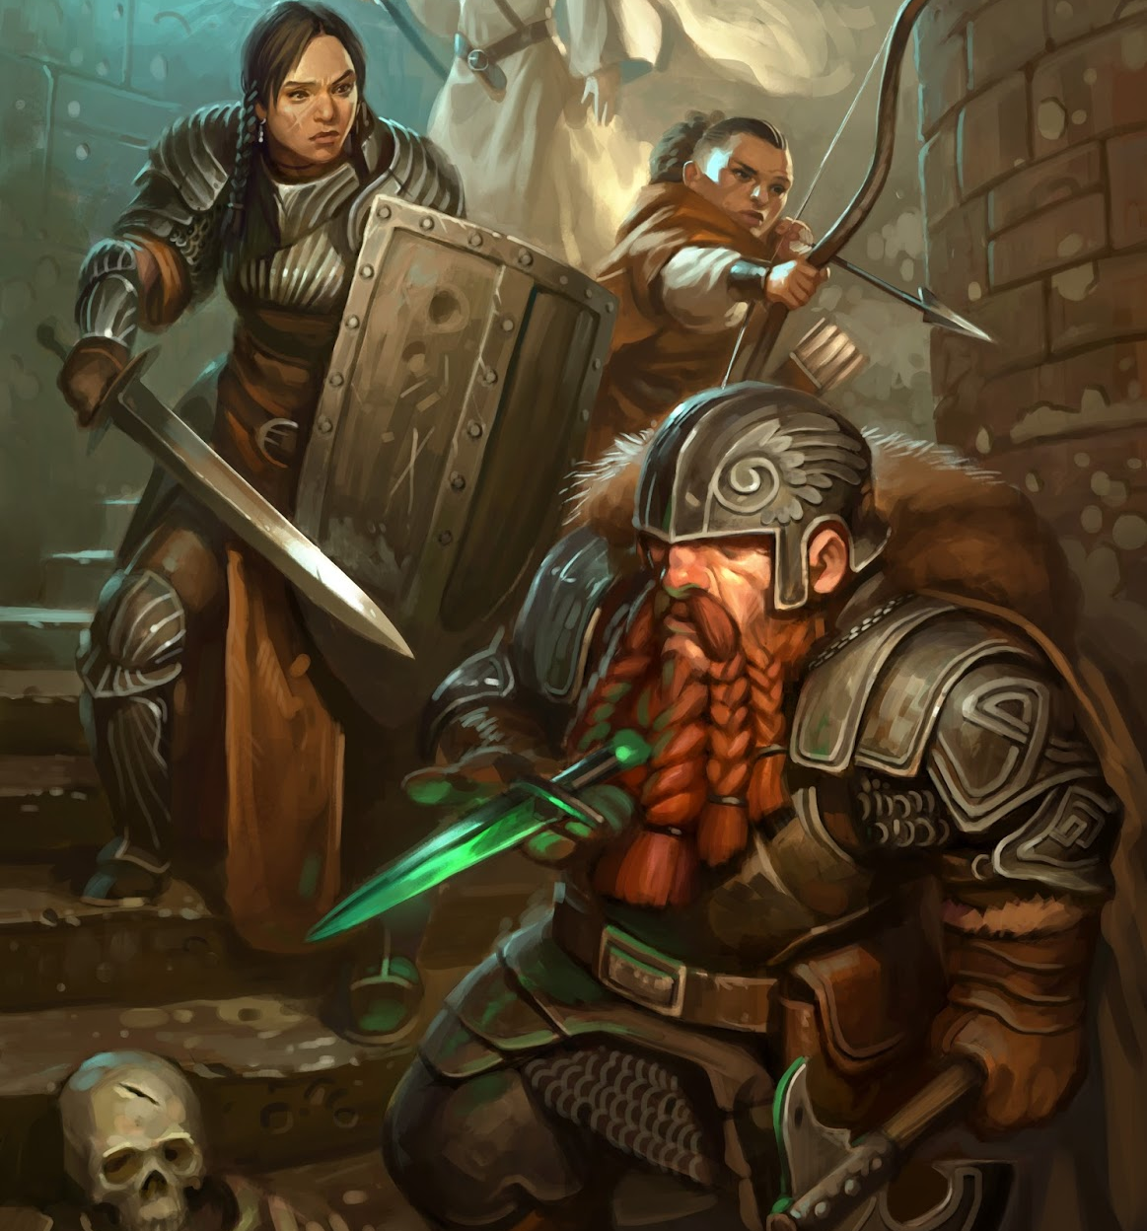
What Problem Does This Solve?
Playing Dungeons & Dragons with friends is a ton of fun!
Preparing the game to be played can easily become a hassle
Outline potential scenes and encounters
Copy monster statistics
Prepare random encounters
Create meaningful Non player characters
There is no guarantee that you will use all you’ve prepared!
The goal of this project is to solve this problem by streamlining the process of preparing a game and help focus on what matters.

Slide 3
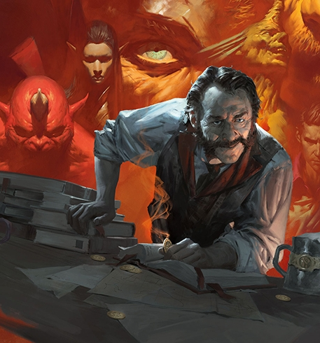
What Is Adventure Day?
It removes busy work of creating and documenting a D&D Adventure while preserving a Dungeon Master’s creativity.
Fetches monster statistics from a Database for easy reference during sessions.
Assists in scaling monster difficulties to fit all levels of Adventuring Parties.
Generates encounters with specific monsters or any monsters from a specified environment.
Generates role playing traits for Non-Player Characters from a list quirks and behaviors.
Formats Story Outline, Monsters and NPCs into a cohesive markdown output for use with the Homebrewery website.

Slide 4

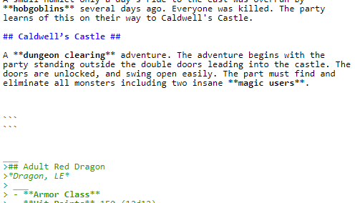
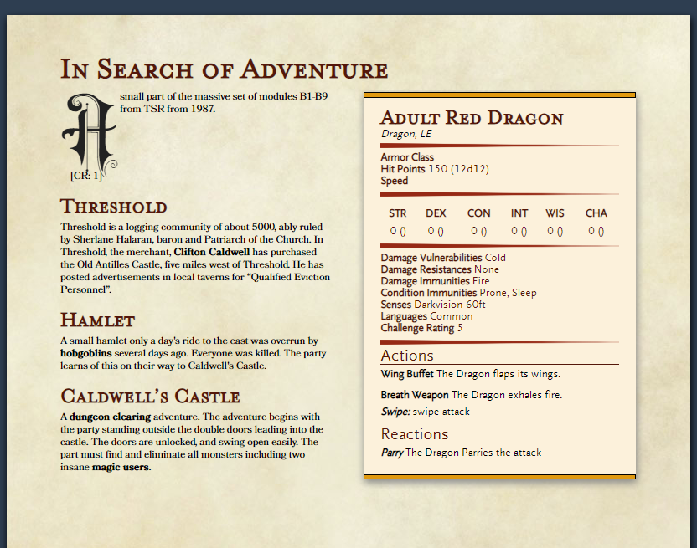
How Can I build An Adventure?
INPUT story ideas for your story into a text file.
SEPARATE scenes with traditional markdown title headings
BOLD important characters that have meaning or are in need of statistics
DEFINE changes to bolded characters and items in the dictionary section
OUTPUT your adventure using a CSS styling.

Slide 5



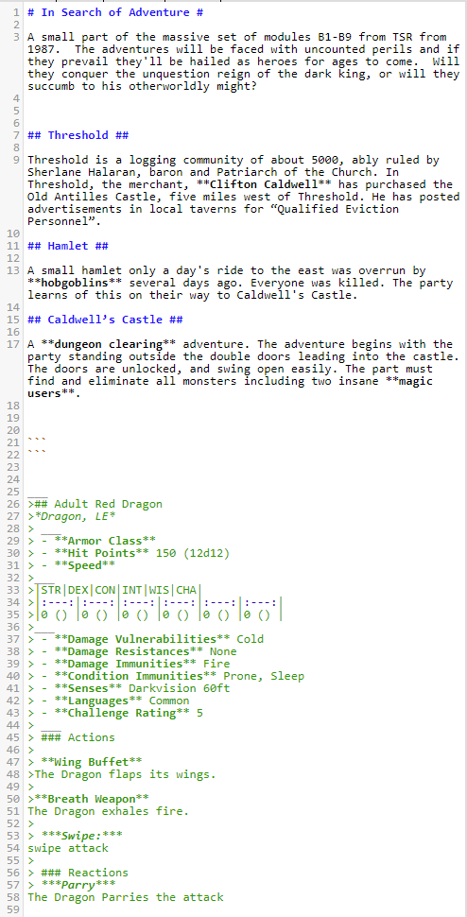
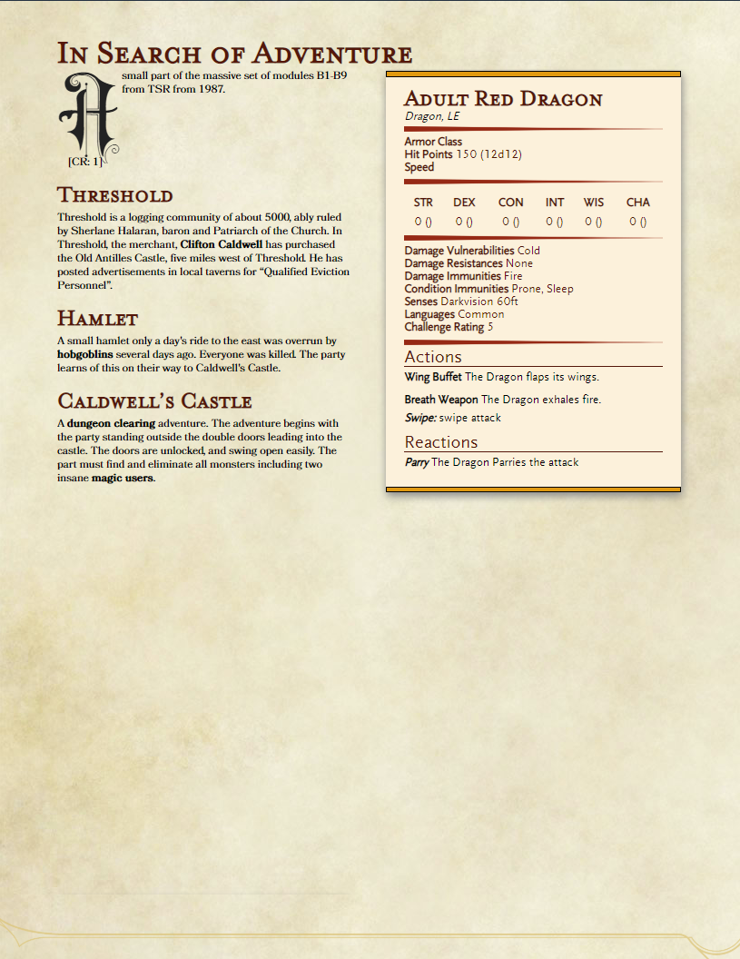

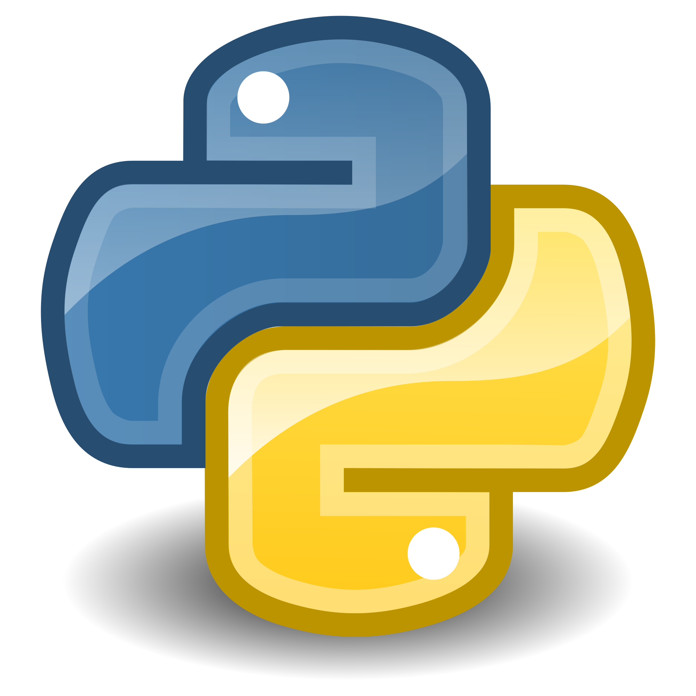
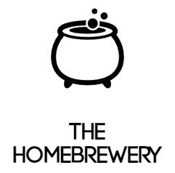
Adventure Day
Overview
Features
Output
Dungeons and Dragons is a role playing game where one player assumes the role of the Dungeon Master. This player is responsible for dreaming up adventures for the other players to embark upon.
Preparing games for dungeons and dragons can be a daunting task that is filled with
A Database filled with monster statistics for use with any D&D adventure.
Monster customization
Addition of Special Abilities
Difficulty scaling
Random Encounter Creation
Based on Terrain type
Created with varying difficulties
Non Player Character (NPC) Traits
Generates character traits / quirks
Text parser that interprets tagged words and headings for formatting
Formatted output in single document that contains all generated and modified monsters.
Solutions
Develop a desktop solution to streamline the creation process of a Dungeons and Dragons session. This was developed in Python in conjunction with a Postgres database to house relevant data for recall.
Users supply story ideas and tag characters of interest in the body of text which will be fetched and represented in the output of the application.
Markdown Input
DB Queries
HTML Parsing

